Slide 1
DRIVING SCHOOL MANAGEMENT SYSTEM
PROJECT GUIDE
Asst. Prof REENA CHERIAN
PRESENTED BY
PRANAV P S
MCAL19011

Slide 2
ABSTRACT
This Advanced “Driving School Management system” can reduce the efforts of human power and wealth very much, and ensure driving-training school’s information resource to be utilized effectively. It helps the driving school to automate the manual tasks of maintaining students, tutors data in database. The system has an admin, The admin can administers the system through admin’s dashboard. Student can access the system on admin’s approval by creating an account online. The system has also a tutor login provided by the admin. Tutor can view his assigned student for training and the next session.

Slide 3
INTRODUCTION
In today’s world, driving has become one of the most important human need. With such kind of thinking driving schools have emerged all over the country to train professional and nonprofessional drivers to meet the ever growing demand for more drivers.
While there exists such kind of demand, observation has shown that most of these schools don’t have proper systems in place to manage such kind of training schools. Most of these schools usually use manual systems which have several problems as opposed to today’s world which needs well managed computer systems to help in such environments.
The “DRIVING SCHOOL MANAGEMENT SYSTEM” is to be developed to replace such computer system in order to provide a better controlled and efficient environment which will meet the needs of the day’s services.

Slide 4
Front End and Back End
FRONT-END
PHP
BACK-END
MYSQL

Slide 5
Modules
Admin Module
The module enables the admin to create and modify the login id and password. This login is useful to access students, tutors, payment and packages details. When authorized person gives valid login id and password, he can access those details.
Login : Admin can login with Id and password.
Manage Vehicle Details : Admin can add, read, update and delete information of vehicles.
Manage Tutor : Admin can add and allot tutor to the student.
Approve : Admin can approve registration request of Students and Tutors
Enquiry : Admin can read the enquiry done by students and they can respond to them.
View Students : Admin can view student detail.
View Session : Admin can view session allotted to students.
Payment : Admin can view payment details. They can also modify the details.

Slide 6
Student Module
In the student module, the student can enter the details(name, address, contact number, mail id, date of birth, gender, and date of joining). All the authorized people can view the student details also.
Register : student can register to get login Id and password.
Login : student can login with Id and password.
Package Selection : student can select packages according to their needs.
My Packages : They can view their package details.
Payment : Student can make payment online.
Details : Student have to upload the needed details and documents.
My Sessions: Student can check his allotted session.
Enquiry : Student can make enquiry.

Slide 7
Tutor Module
This module has the Driver details such as driver id, name, address, qualification, contact number and etc.. Admin can add, update and remove the driver details.
Login: Tutor can login with Id and password.
My Profile: Tutor can view and edit his own profile.
My Sessions: Tutor can check his allotted session.
Attendance : Provide attendance for the students.

Slide 8
UML DIAGRAMS

Slide 9
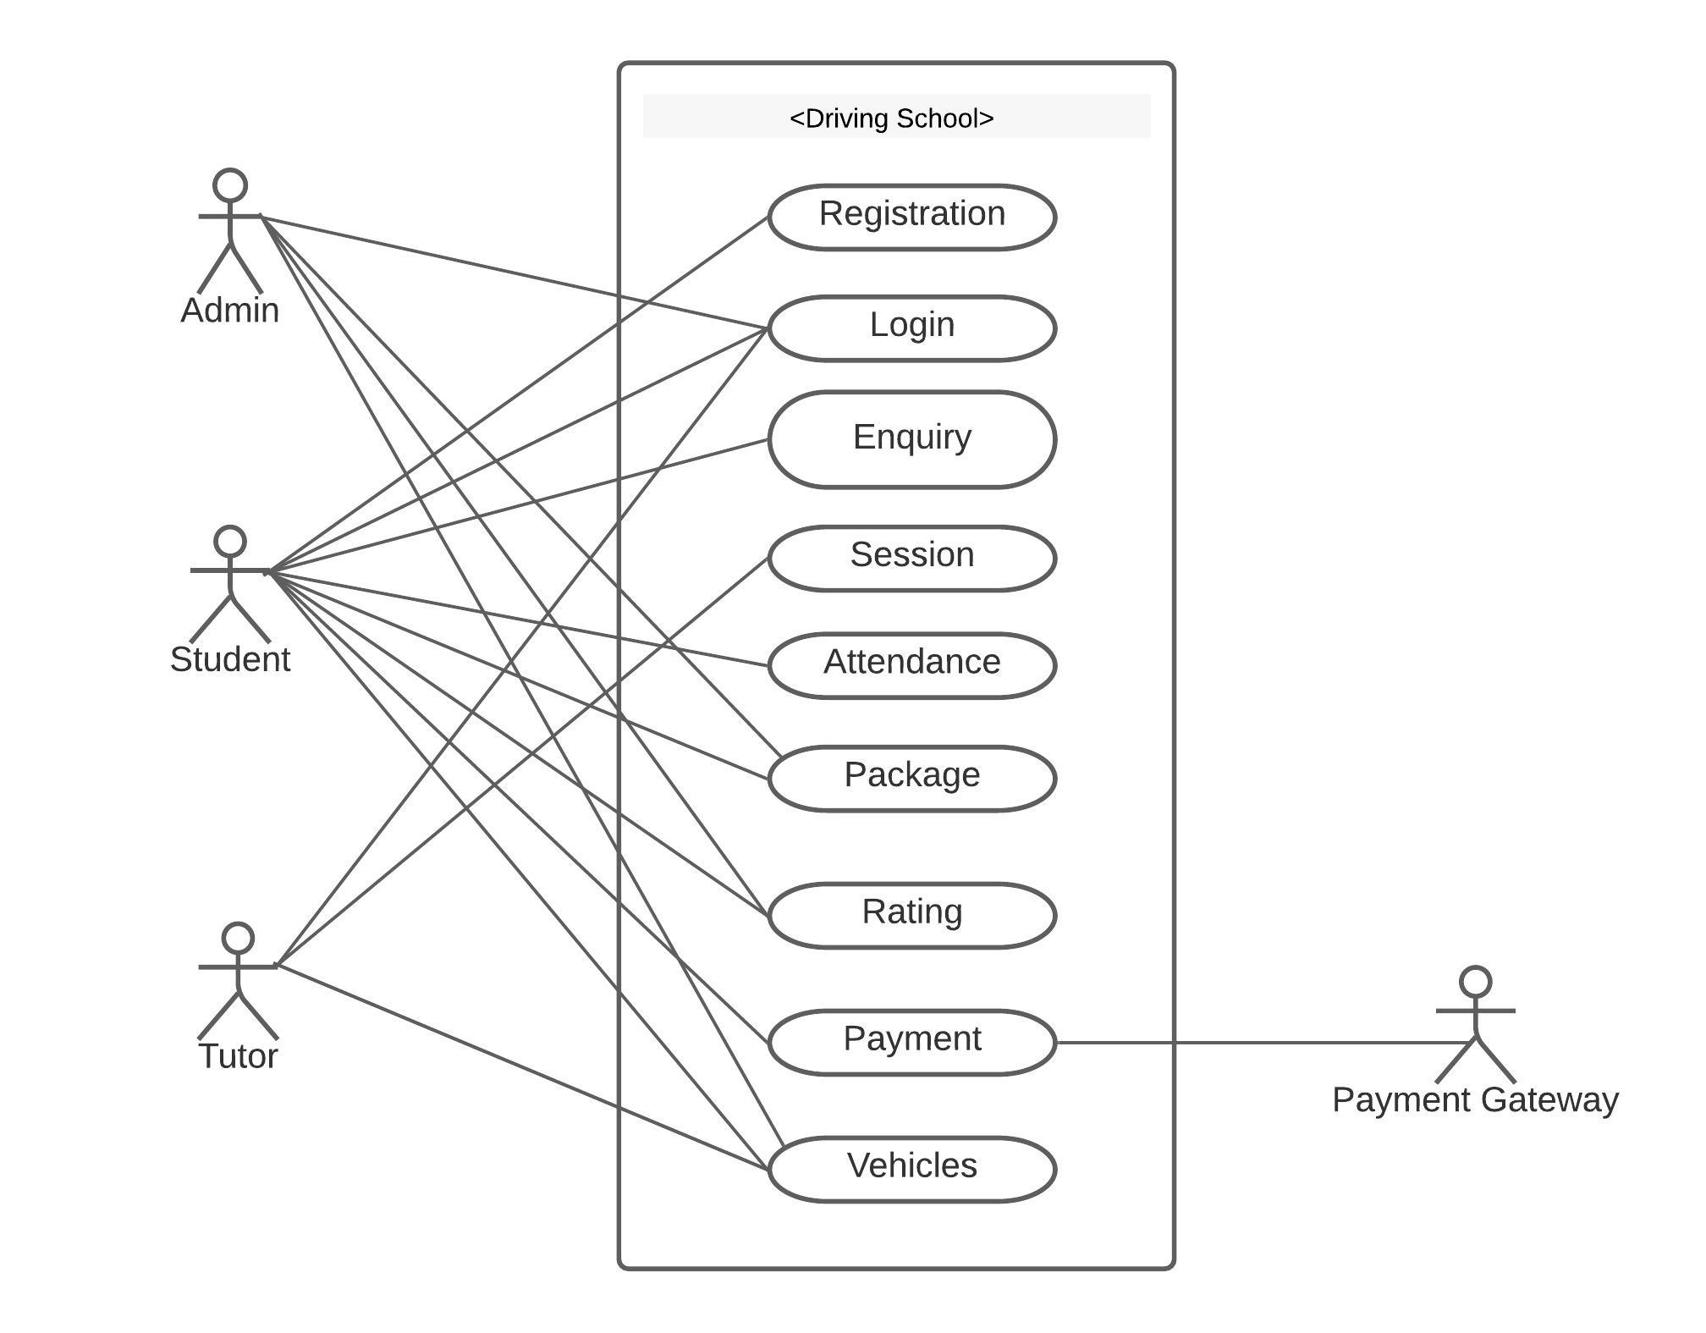
USECASE DIAGRAM

Slide 10
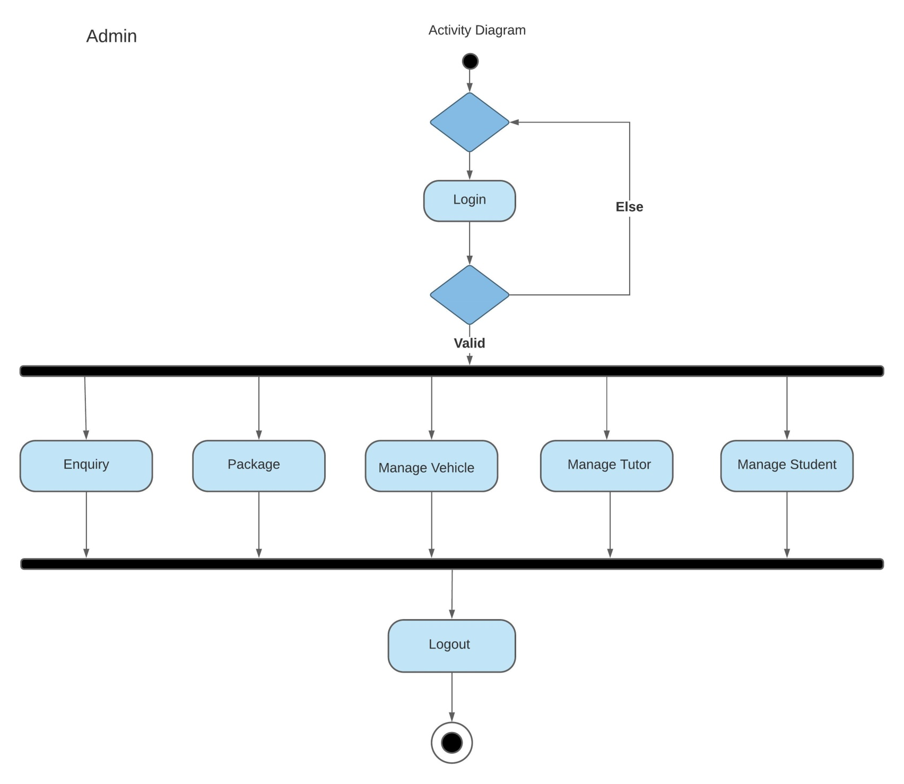
ACTIVITY DIAGRAM

Slide 11
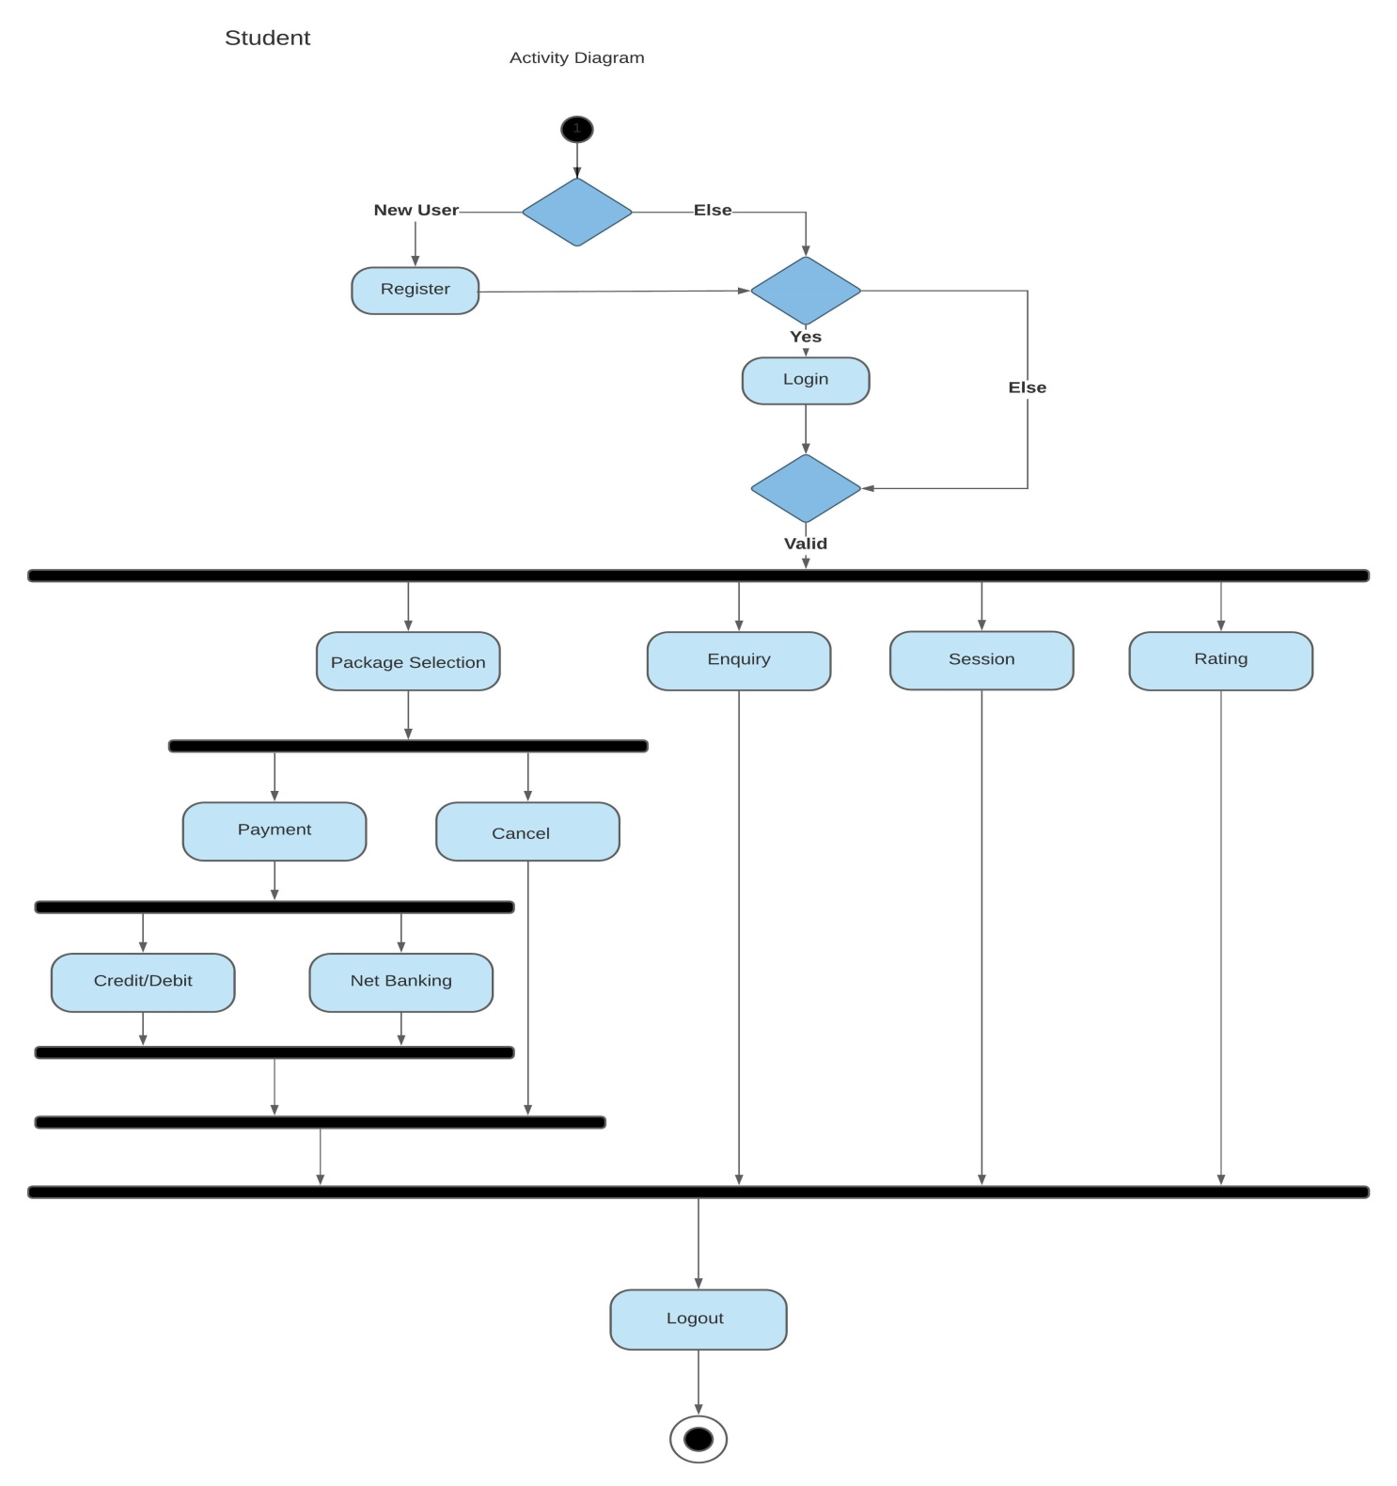

Slide 12
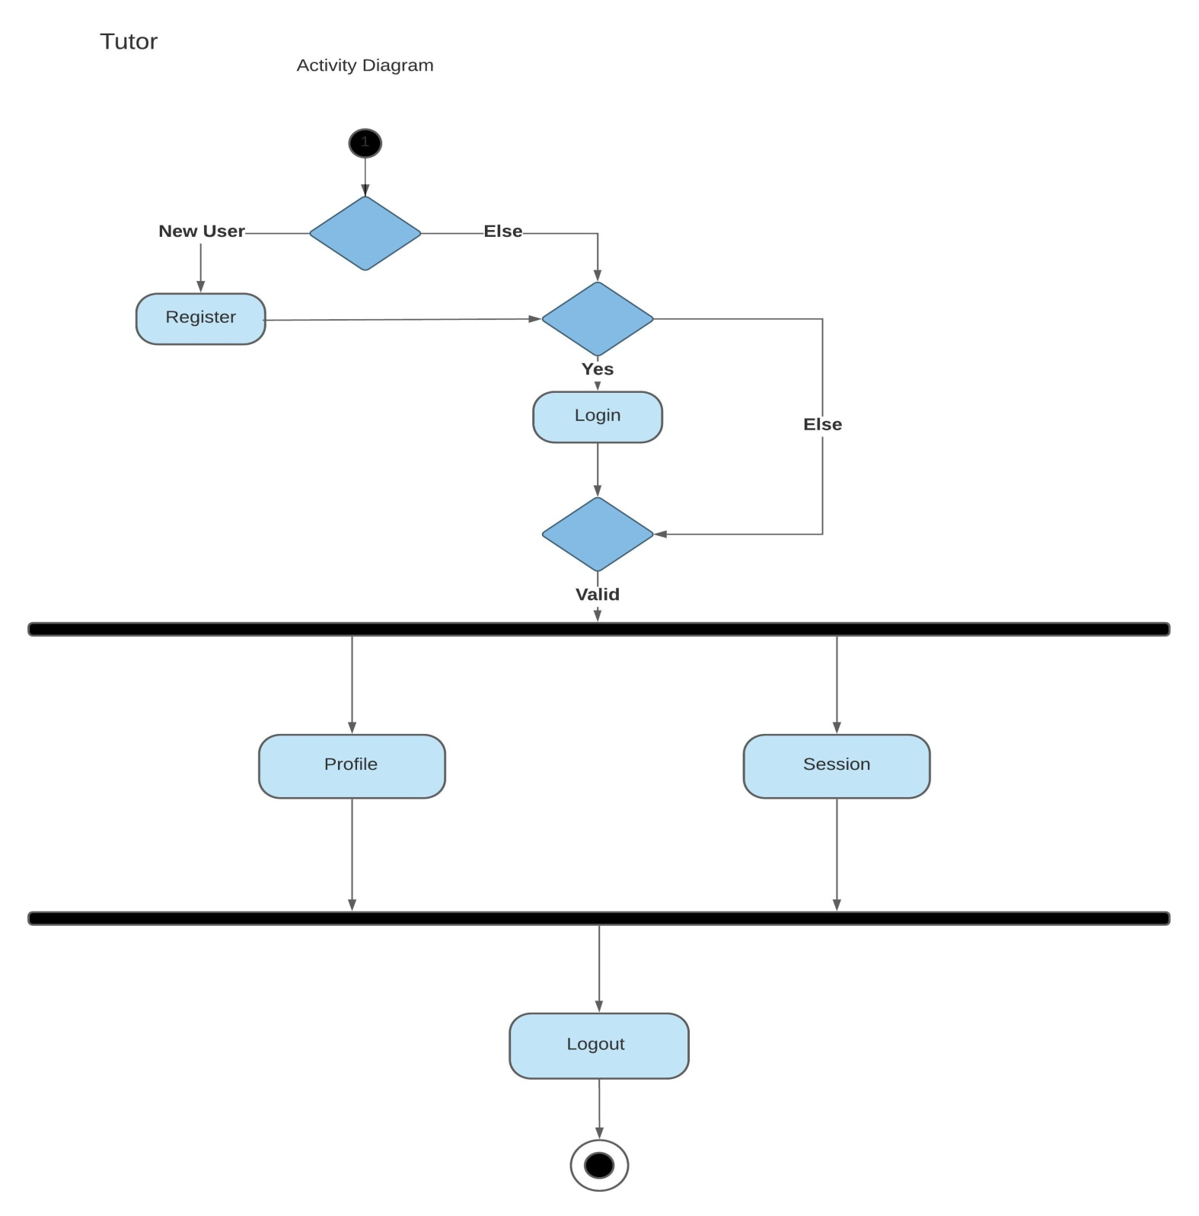

Slide 13
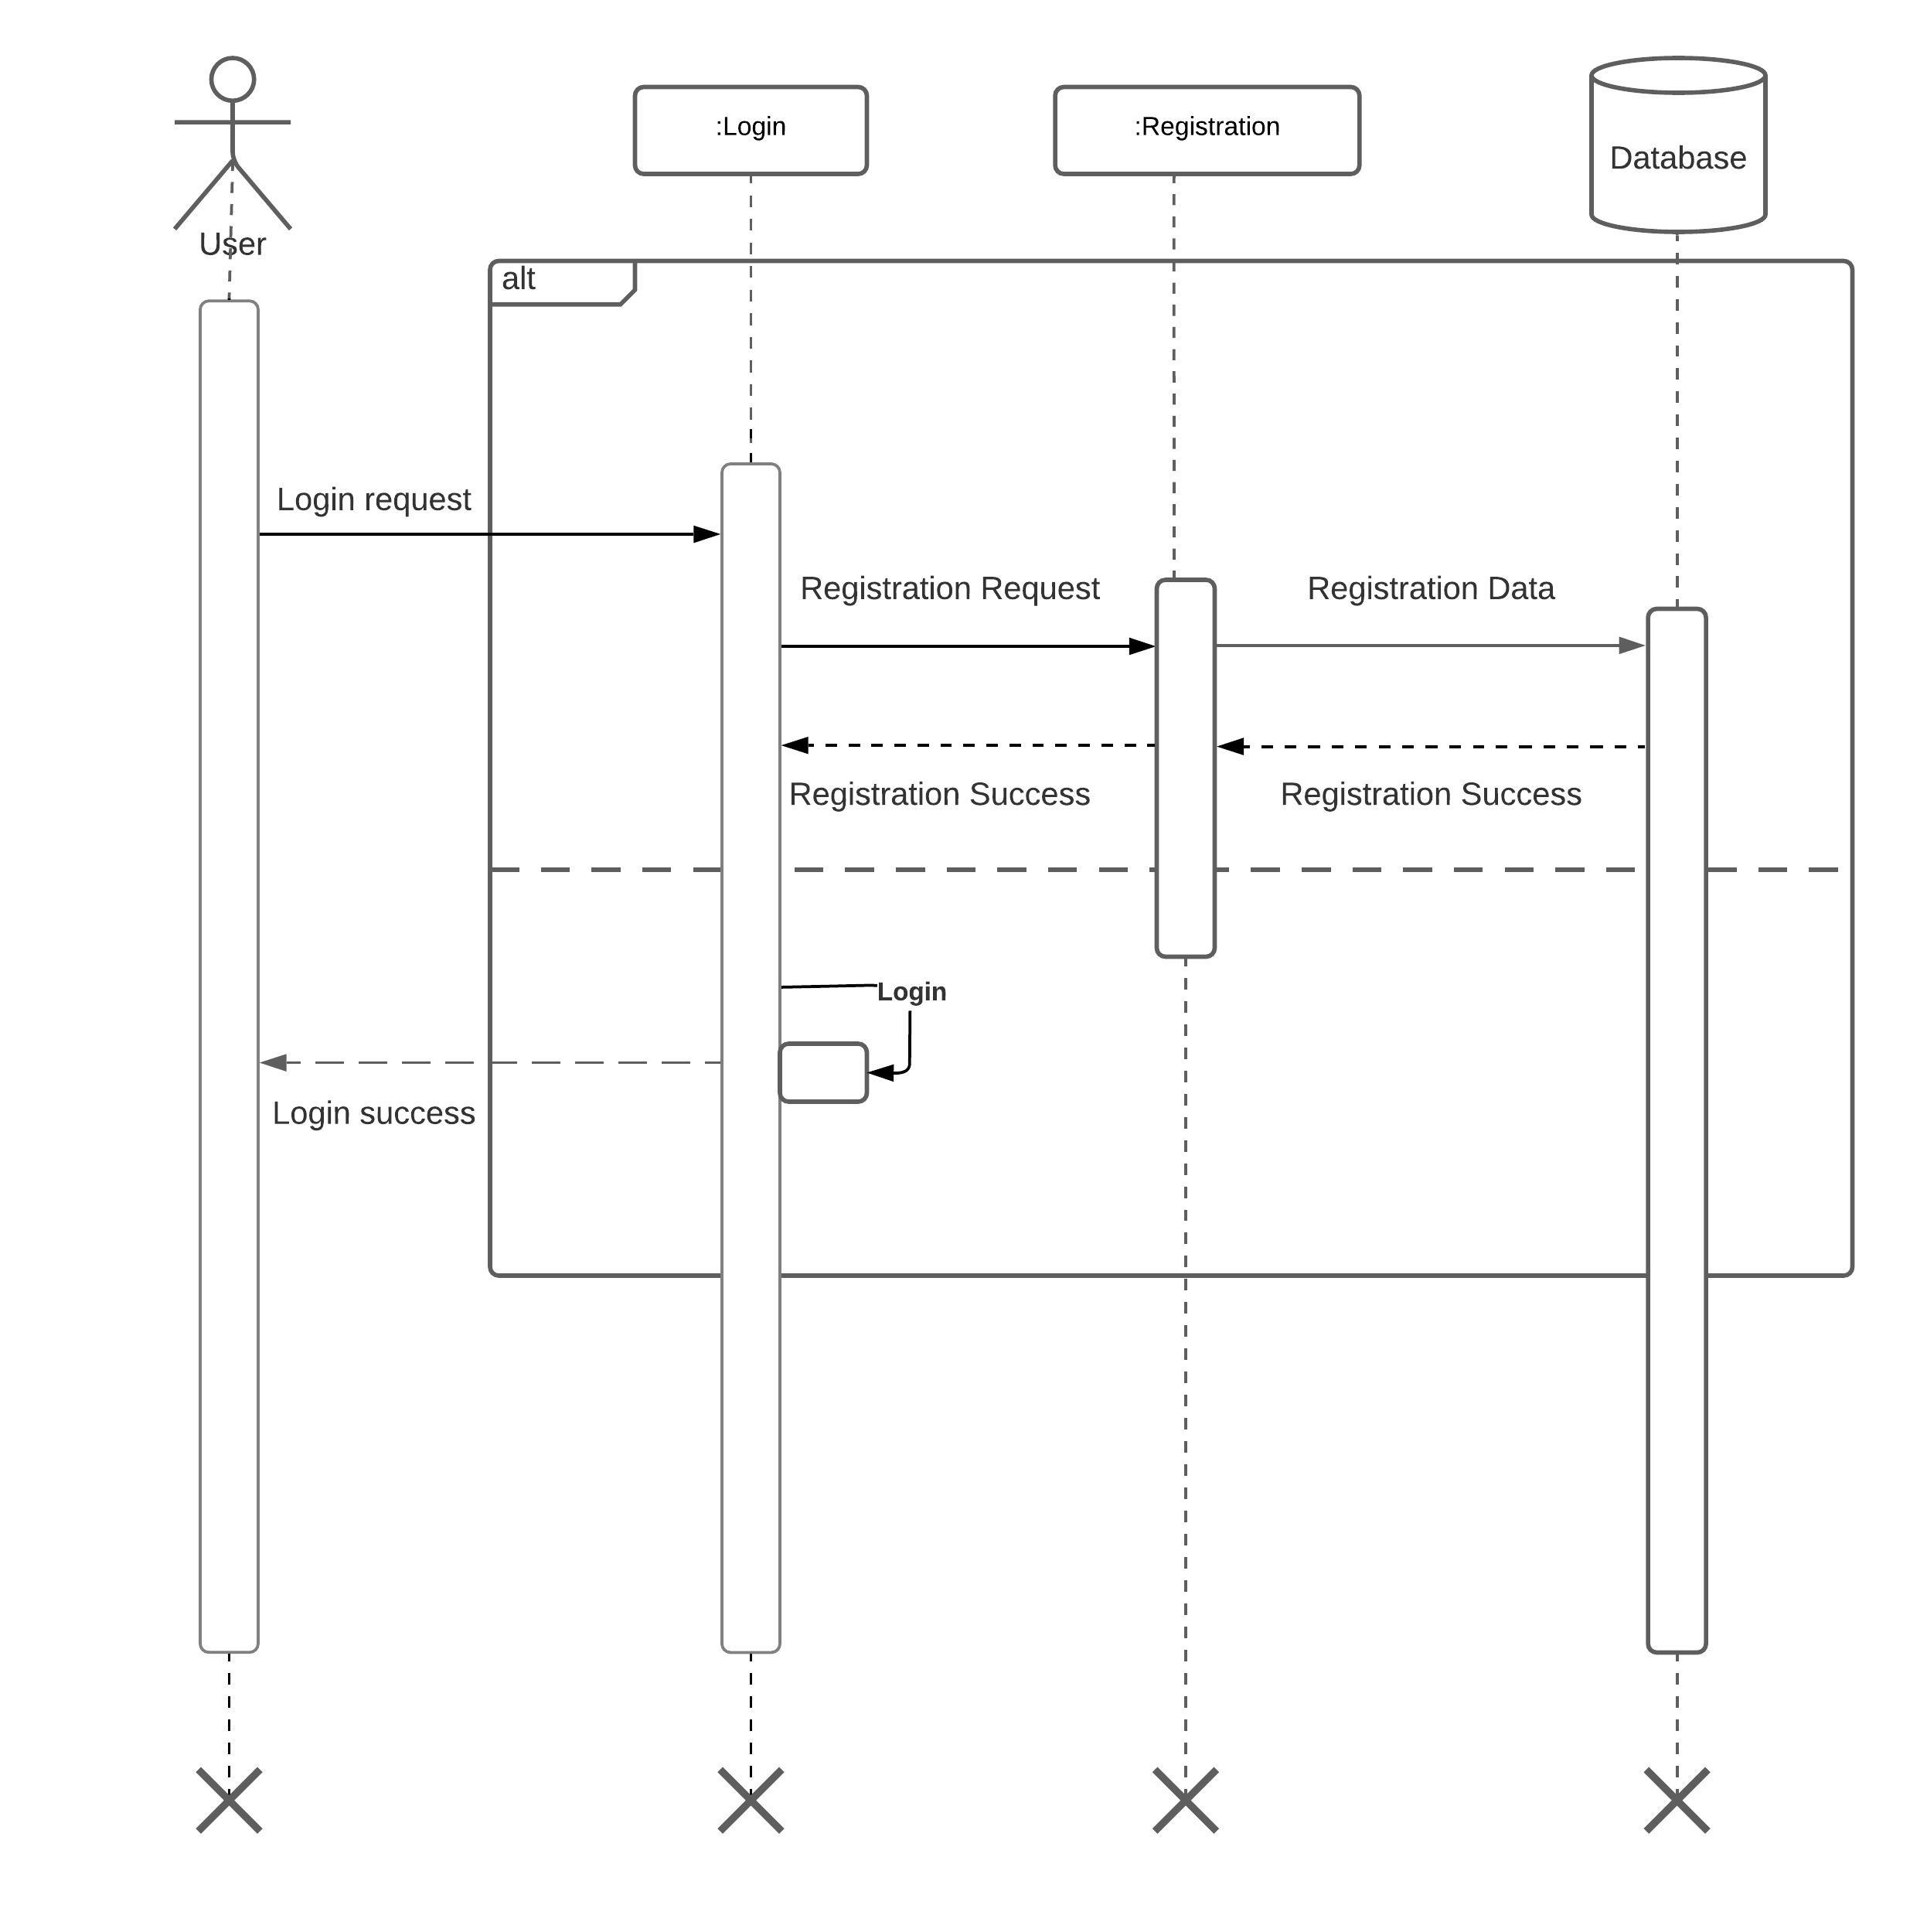
SEQUENCE DIAGRAM

Slide 14
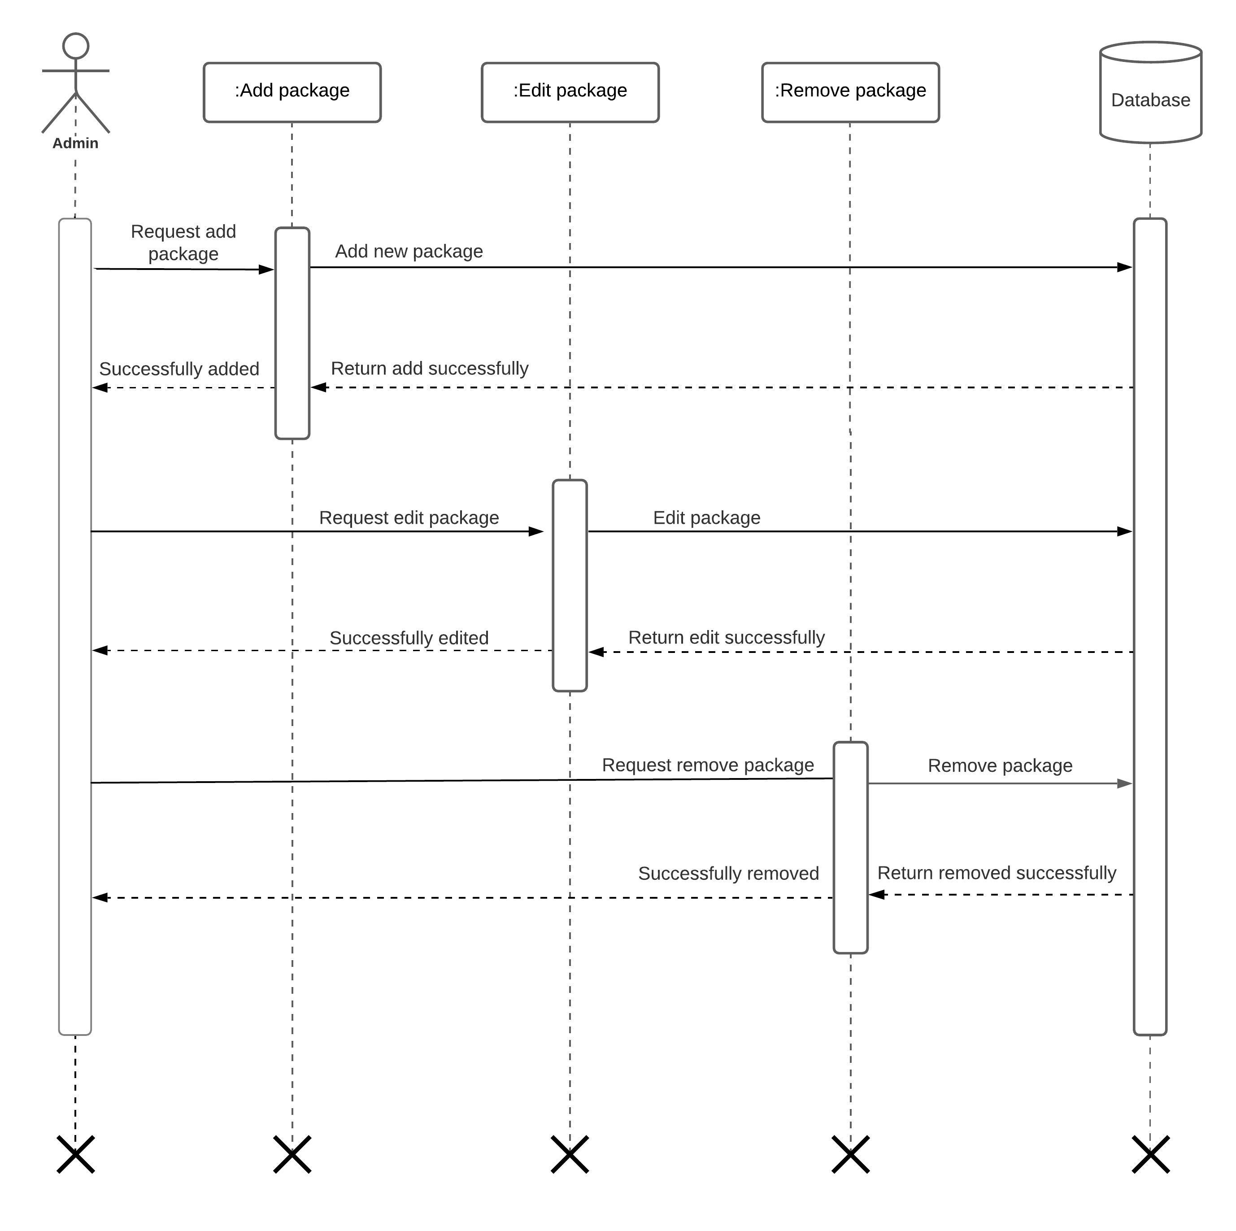
PACKAGE

Slide 15
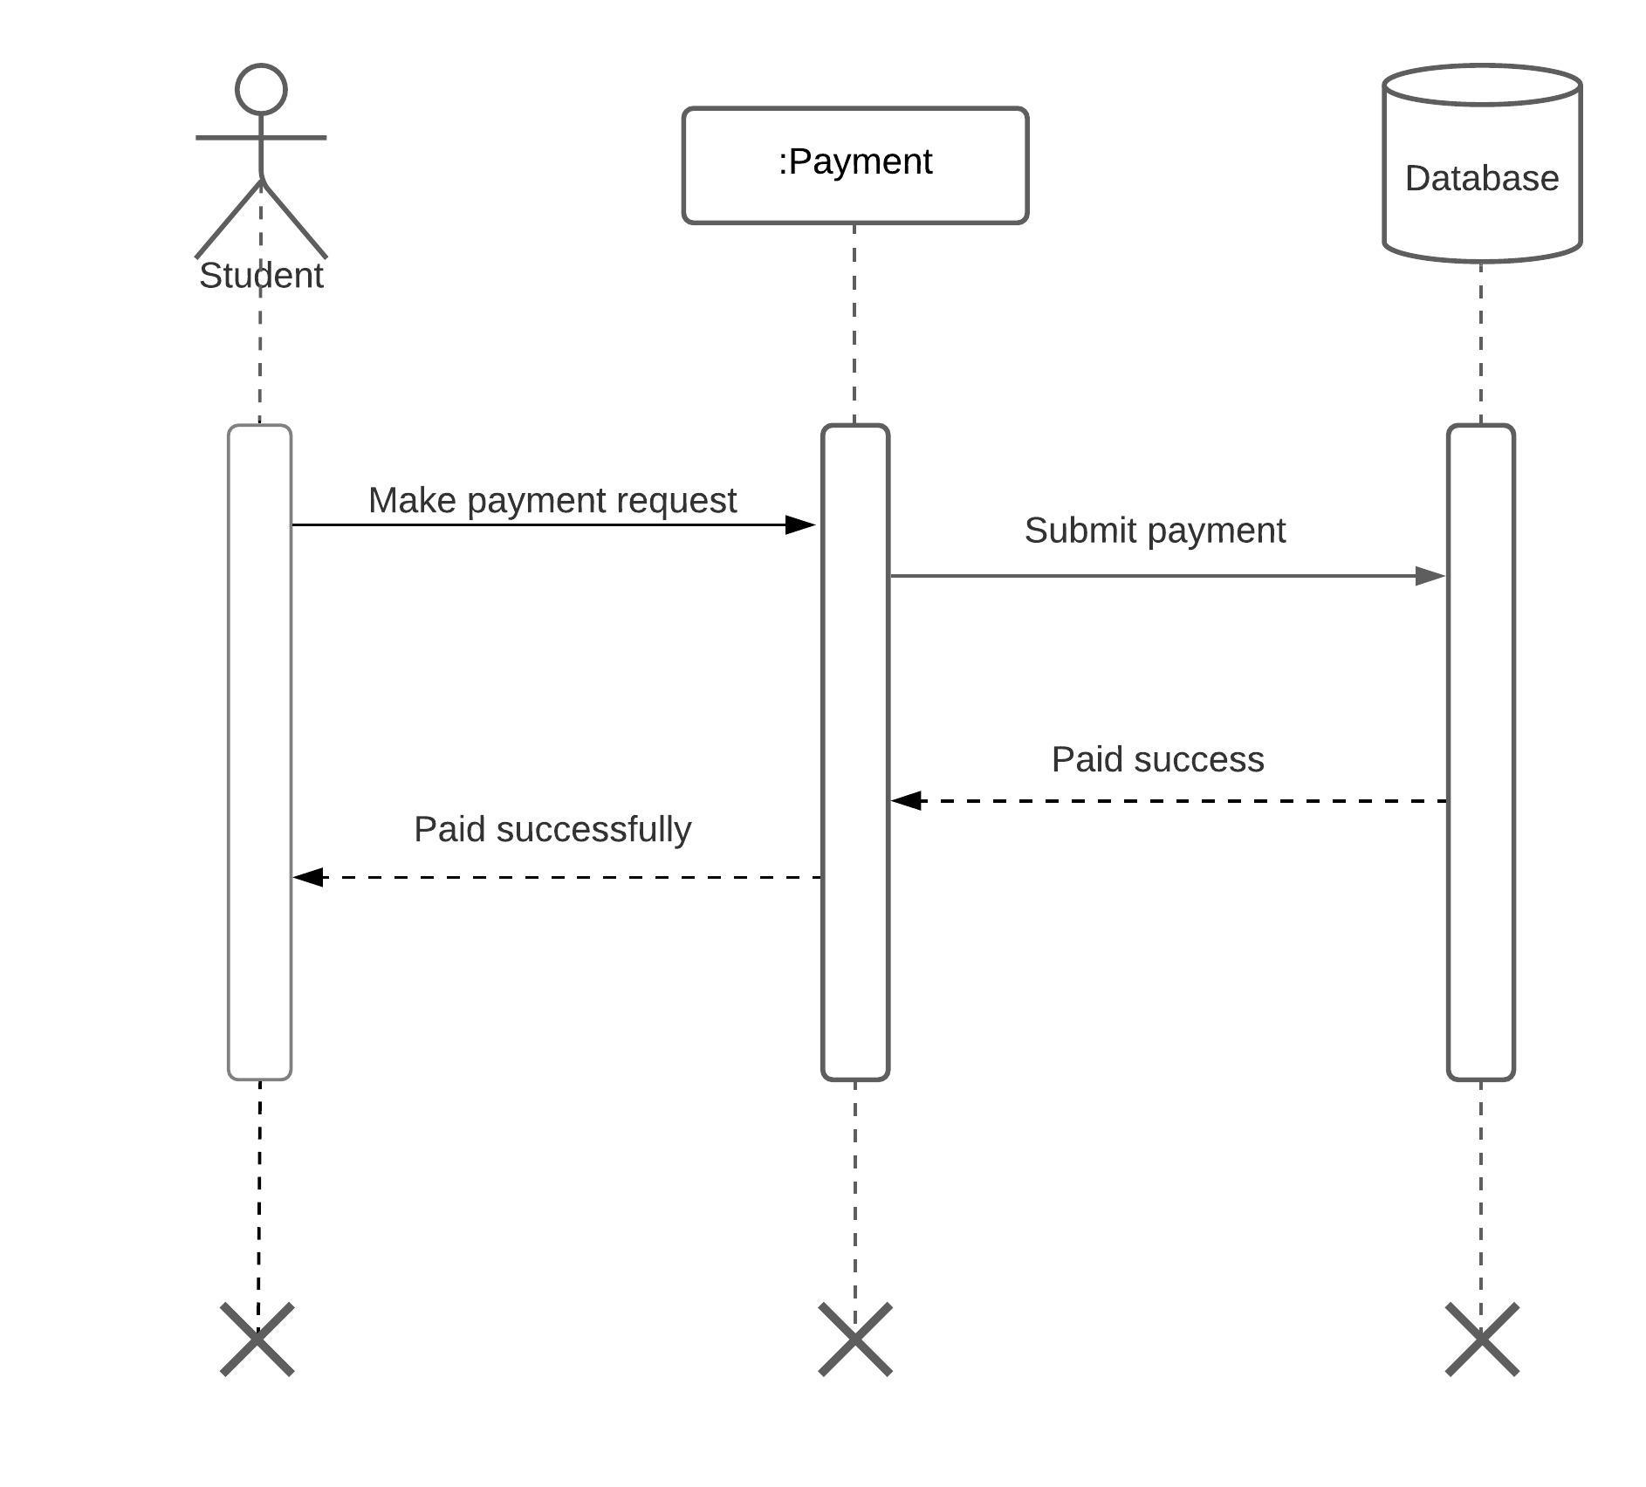
PAYMENT

Slide 16
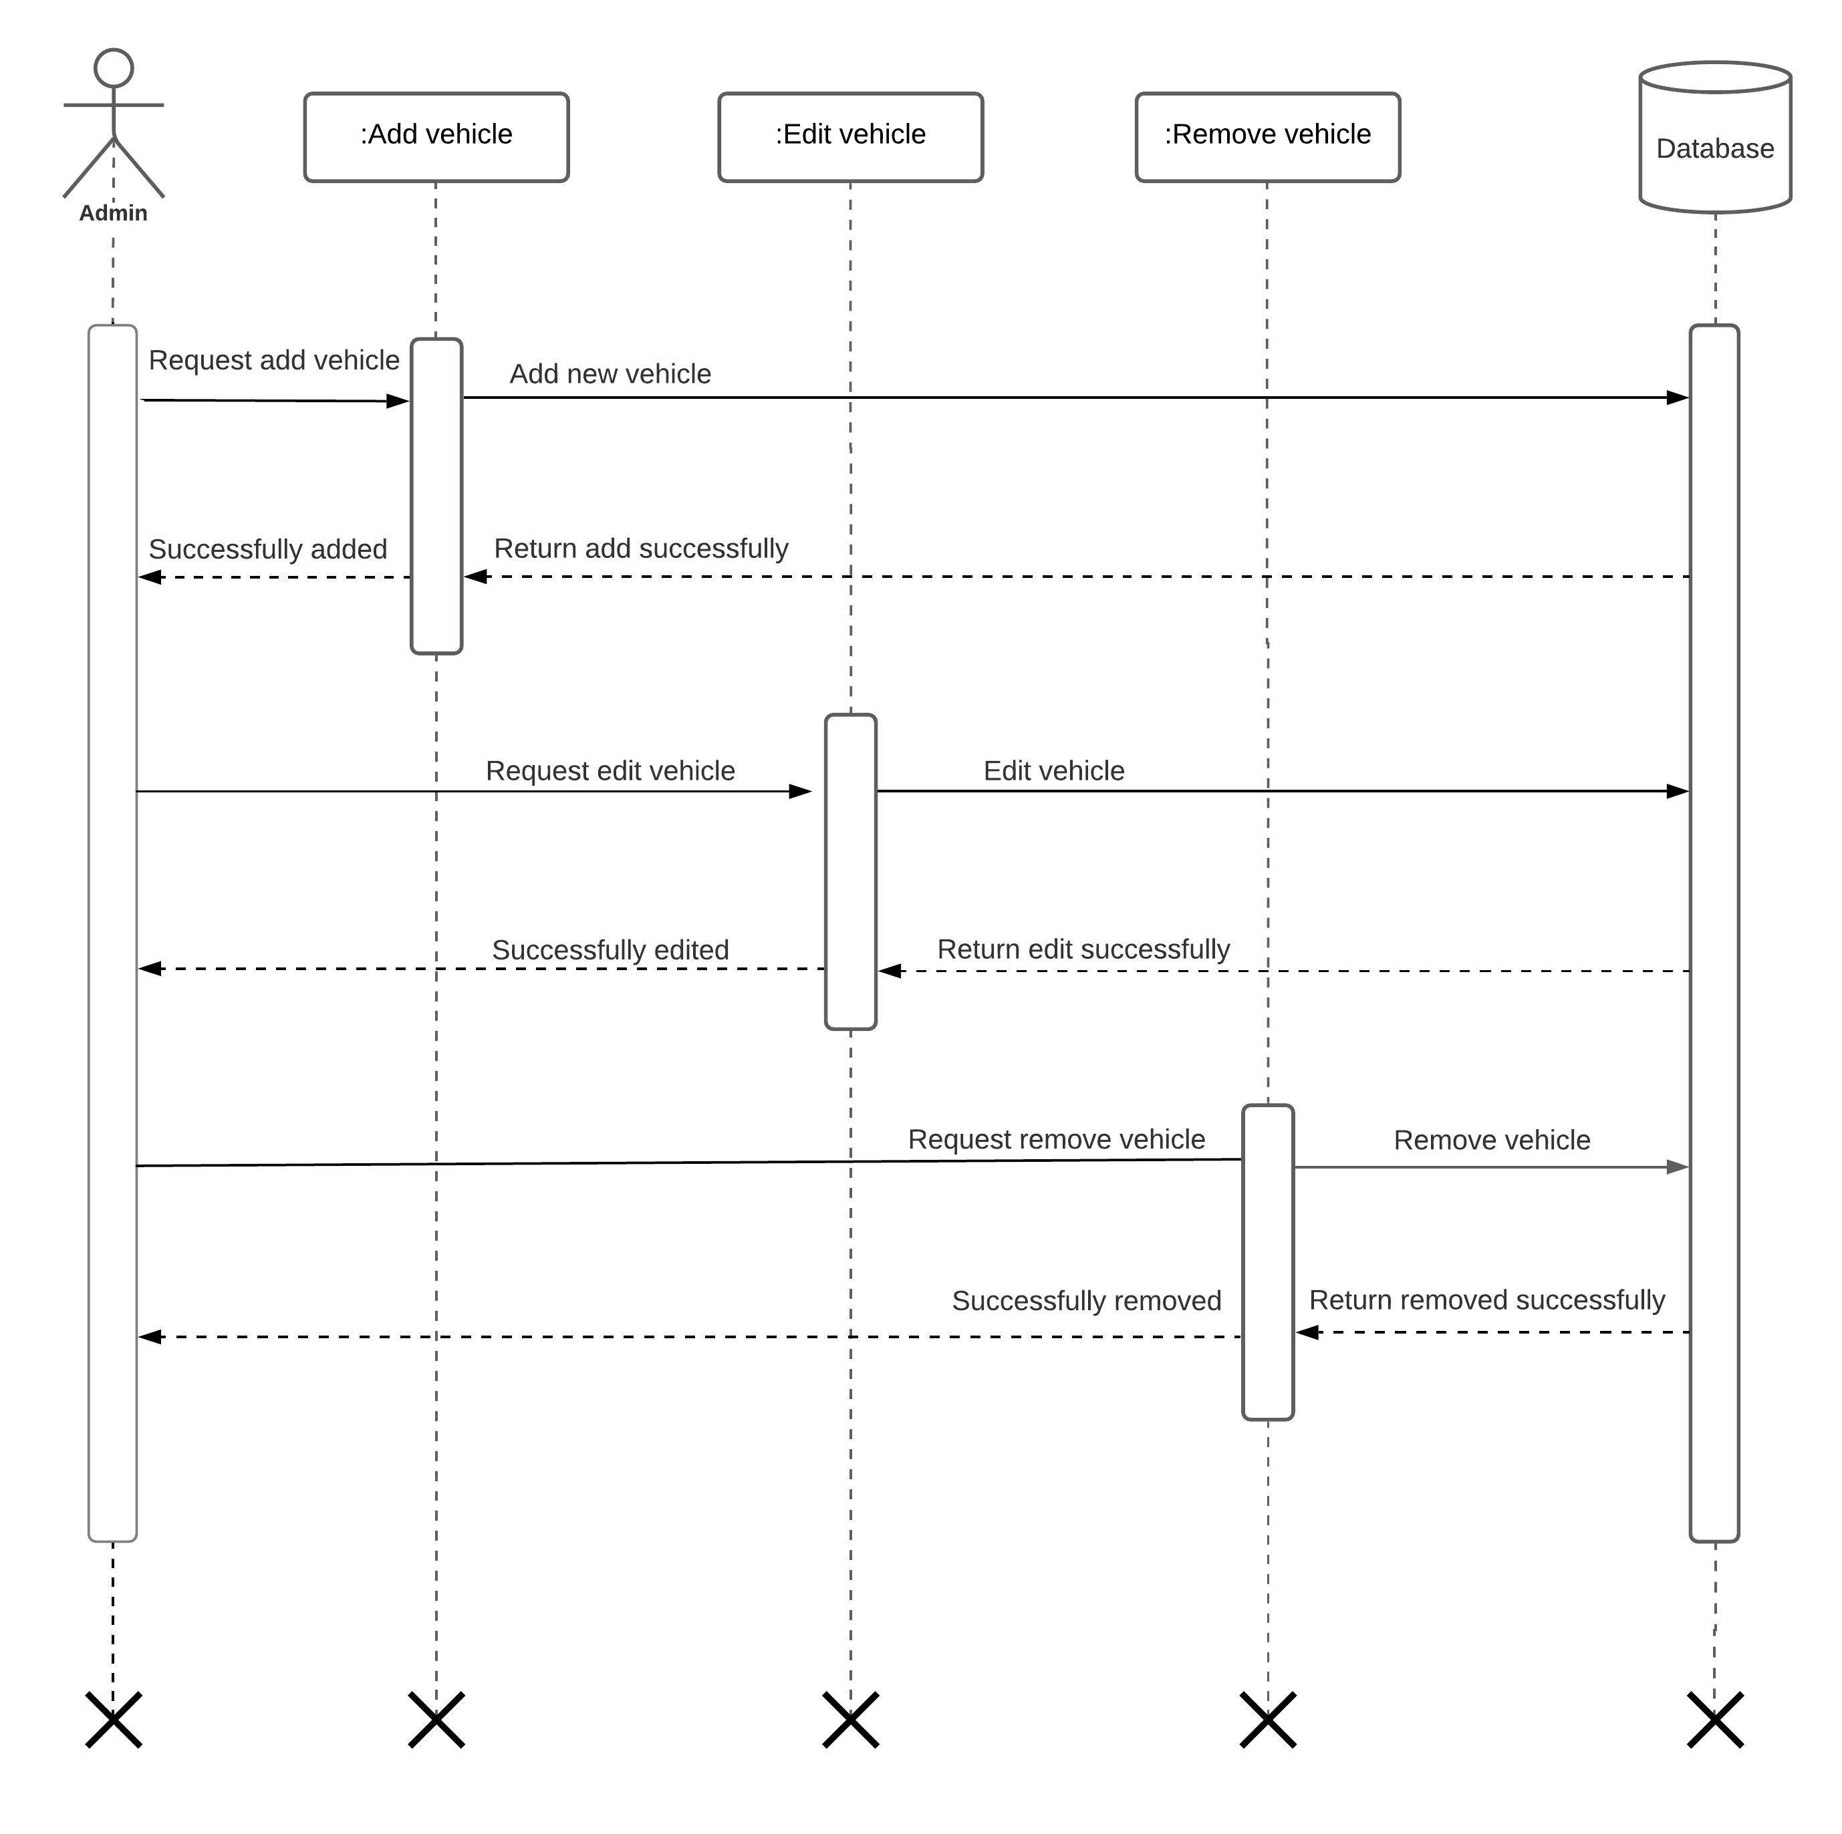
VEHICLE

Slide 17
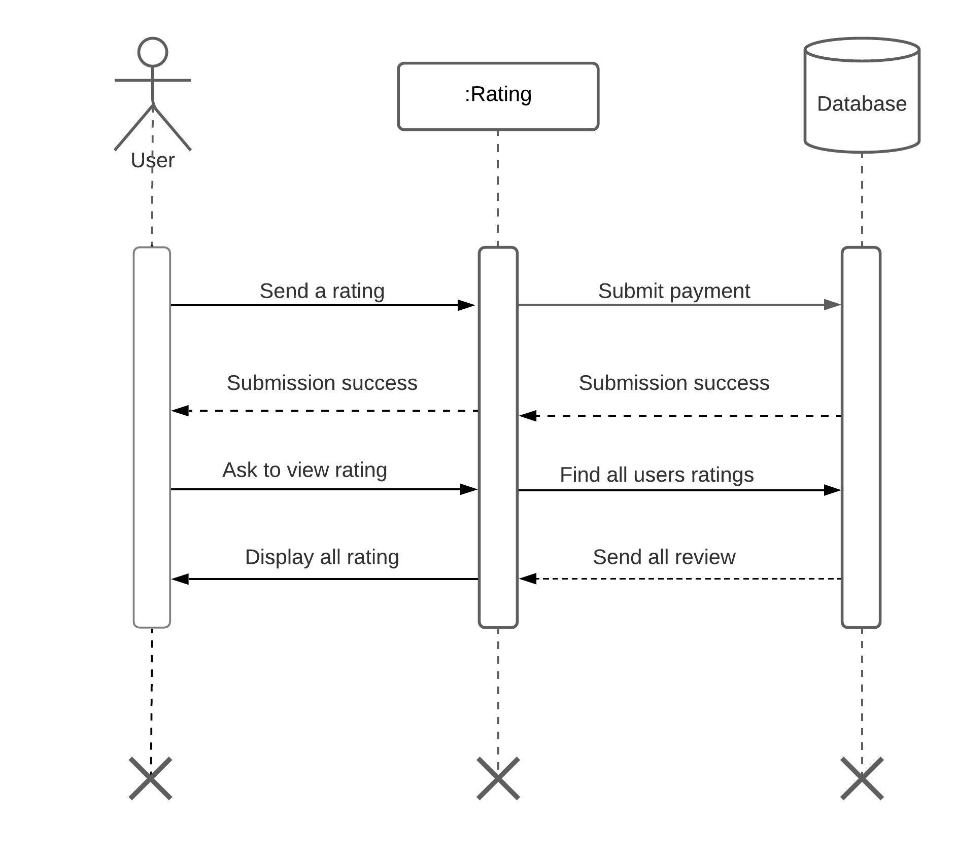
RATING

Slide 18
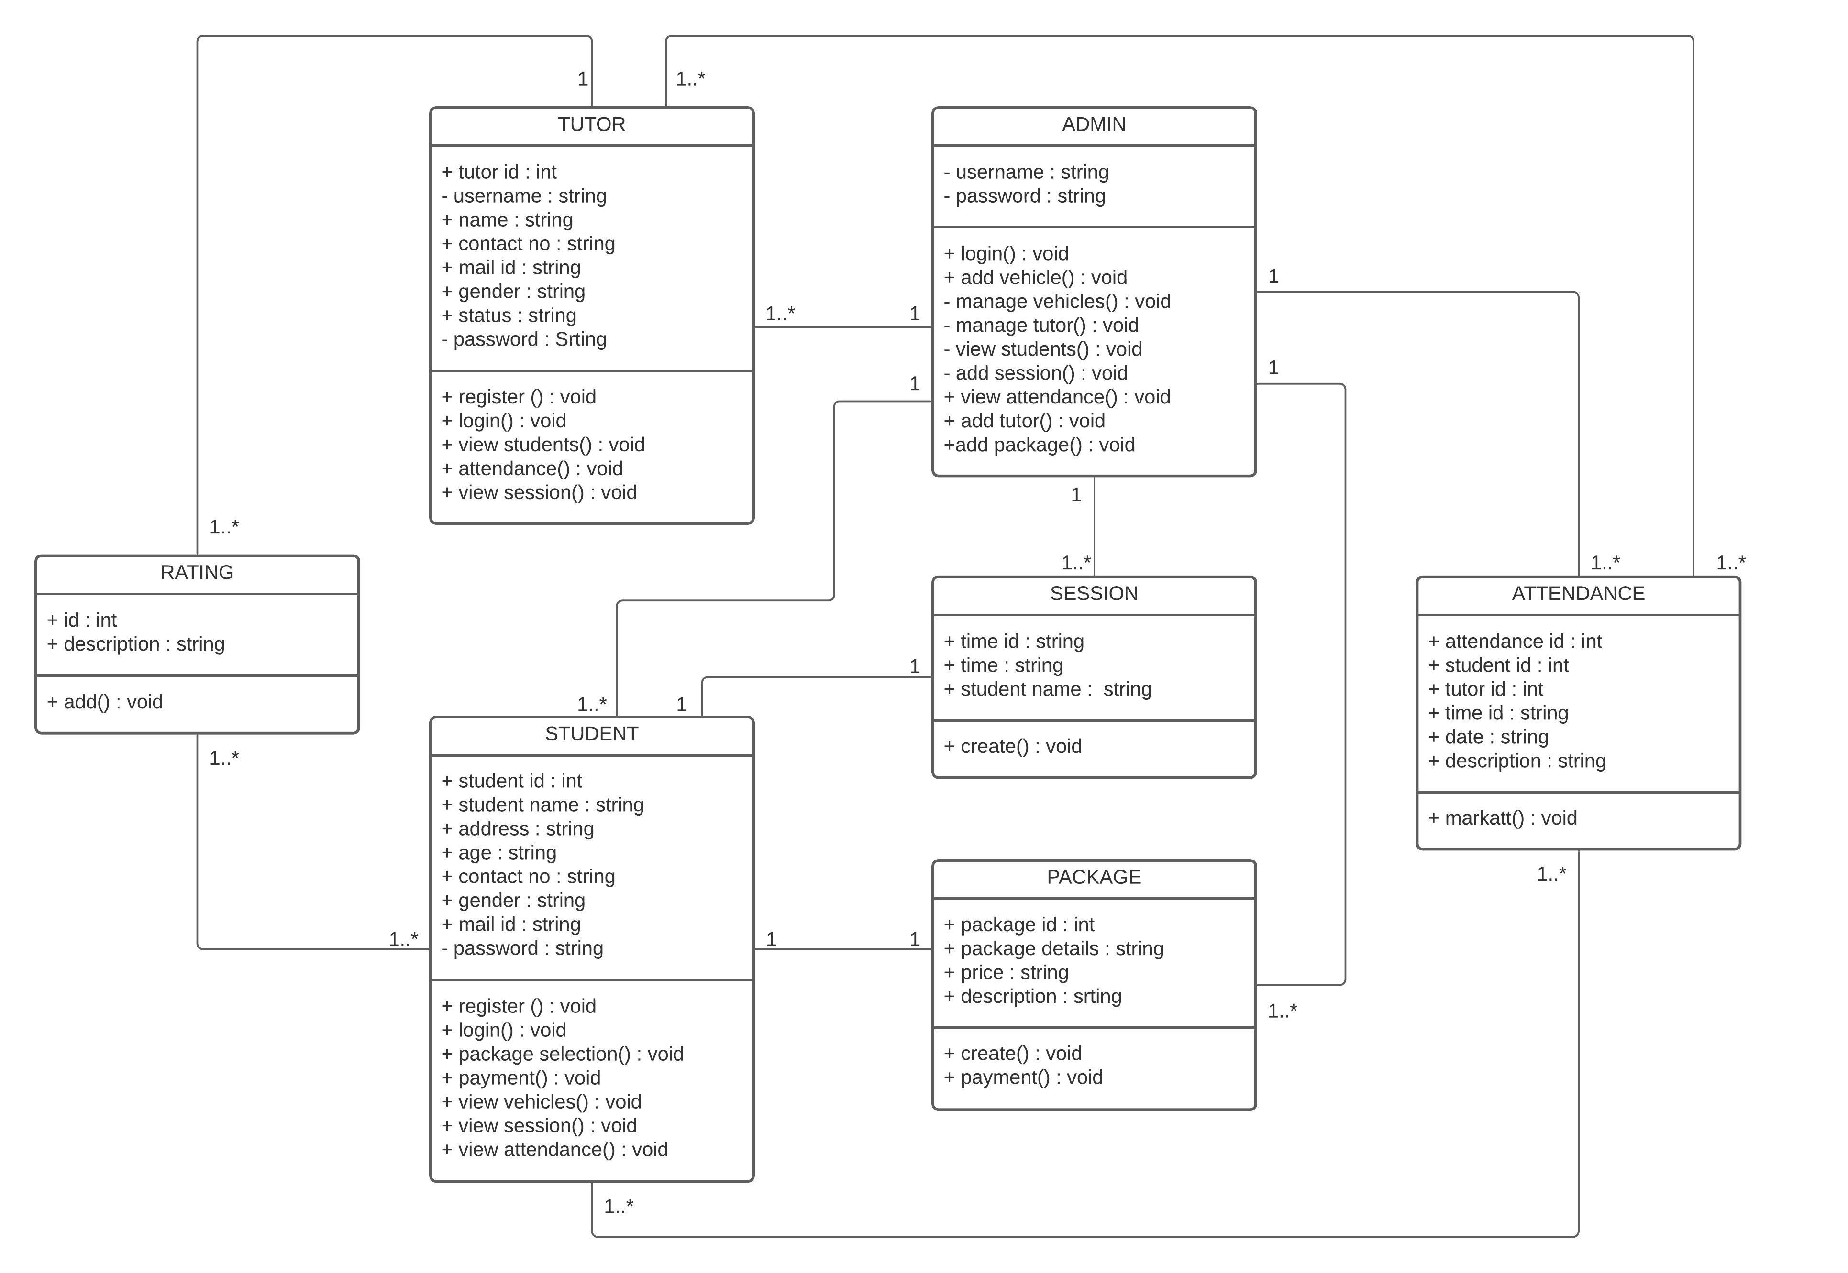
CLASS DIAGRAM

Slide 19
TABLE DESIGN

Slide 20
1. TABLE NAME : LOGIN
FIELD | DATA TYPE | CONSTRAINTS | DESCRIPTION
login_id | Int(11) | Primary key | Login id of users
Username | Varchar(30) | Not null | Username of users
Password | Varchar(30) | Not null | Password of users
user_type | Varchar(30) | Not null | Type of user

Slide 21
2. TABLE NAME : STUDENT
FIELD | DATA TYPE | CONSTRAINTS | DESCRIPTION
student_id | Int(11) | Primary key | Id od student
login_id | Int(11) | Not null | Login id of student
first_name | Varchar(30) | Not null | First name of student
last_name | Varchar(30) | Not null | Last name of student
hname | Varchar(30) | Not null | House name of student
place | Varchar(30) | Not null | Place of student
district | Varchar(30) | Not null | District of student
dob | Varchar(30) | Not null | Date of birth of student
gender | Varchar(30) | Not null | Gender of student
email | Varchar(30) | Not null | Email id of student
phone | Varchar(30) | Not null | Phone number of student

Slide 22
3. TABLE NAME : PACKAGE
FIELD | DATA TYPE | CONSTRAINTS | DESCRIPTION
id | Int(10) | Primary key | PACKAGE ID
package | Varchar(30) | Not null | PACKAGE DETAILS
price | Int(10) | Not null | PACKAGE PRICE
description | Varchar(50) | Not null | PACKAGE DESCRIPTION
date | date | Not null | Date

Slide 23
4. TABLE NAME : PAYMENT
FIELD | DATA TYPE | CONSTRAINTS | DESCRIPTION
payment_id | Int(11) | Primary key | PAYMENT ID
ap_id | Int(11) | Not null | Apply id
amount | Varchar(30) | Not null | Payment amount
type | Varchar(30) | Not null | Payment type
date | Varchar(30) | Not null | date

Slide 24
5. TABLE NAME : TUTOR
FIELD | DATA TYPE | CONSTRAINTS | DESCRIPTION
staff_id | Int(11) | Primary key | Tutor id
login_id | Int(11) | Not null | Login id of tutor
first_name | Varchar(30) | Not null | First name of tutor
last_name | Varchar(30) | Not null | Last name of tutor
gender | Varchar(30) | Not null | Gender of tutor
dob | Varchar(30) | Not null | Date of birth of tutor
ph_no | Varchar(30) | Not null | Phone number of tutor
email | Varchar(30) | Not null | Email id of tutor
address | Varchar(30) | Not null | Address of tutor
district | Varchar(30) | Not null | District of tutor
photo | Varchar(30) | Not null | Photo of tutor

Slide 25
6. TABLE NAME : ATTENDANCE
FIELD | DATA TYPE | CONSTRAINTS | DESCRIPTION
id | Int(11) | Primary key | Attendance id
student_id | Int(11) | Foreign key | Student id from student table
staff_id | Int(11) | Foreign key | Tutor id from staff table
status | Varchar(11) | Not null | Status
date | Date | Not null | Date

Slide 26
7. TABLE NAME : SESSION
FIELD | DATA TYPE | CONSTRAINTS | DESCRIPTION
id | Int(11) | Primary key | Session id
student_id | Int(11) | Foreign key | Student id from student table
staff_id | Int(11) | Foreign key | Tutor id from tutor table
pack_id | Int(11) | Not null | Package id
time | Varchar(30) | Not null | Time
sdate | Date | Not null | Start date
edate | Date | Not null | End date
date | Date | Not null | Date
status | Varchar(20) | Not null | Status

Slide 27
8. TABLE NAME : APPLY
FIELD | DATA TYPE | CONSTRAINTS | DESCRIPTION
id | Int(11) | Primary key | Session id
student_id | Int(11) | Foreign key | Student id from student table
photo | Varchar(50) | Not null | Photo of student
sign | Varchar(50) | Not null | Sign of student
pack_id | Int(10) | Foreign key | Package id from session table
proof1 | Varchar(50) | Not null | Proof 1
proof2 | Varchar(50) | Not null | Proof 2
eye | Varchar(50) | Not null | Eye test
blood | Varchar(50) | Not null | Blood test
date | Varchar(30) | Not null | Date
status | Varchar(30) | Not null | status

Slide 28
9. TABLE NAME : VEHICLE
FIELD | DATA TYPE | CONSTRAINTS | DESCRIPTION
V_ID | INT(10) | PRIMARY KEY | VEHICLE ID
V_NAME | VARCHAR(10) | NOT NULL | VEHICLE NAME
V_TYPE | VARCHAR(10) | NOT NULL | VEHICLE TYPE

Slide 29
10. TABLE NAME : COMPLAINT
FIELD | DATA TYPE | CONSTRAINTS | DESCRIPTION
complaint_id | Int(11) | Primary key | Complaint id
student_id | Int(11) | Foreign key | Student id from student table
complaint | Varchar(100) | Not null | Complaint
reply | Varchar(100) | Not null | Replay
date | Varchar(20) | Not null | Date

Slide 30
SCREEN SHOTS

Slide 31
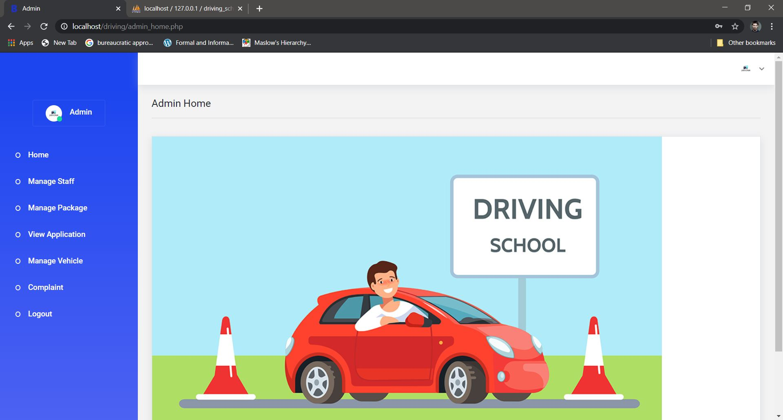
ADMIN

Slide 32
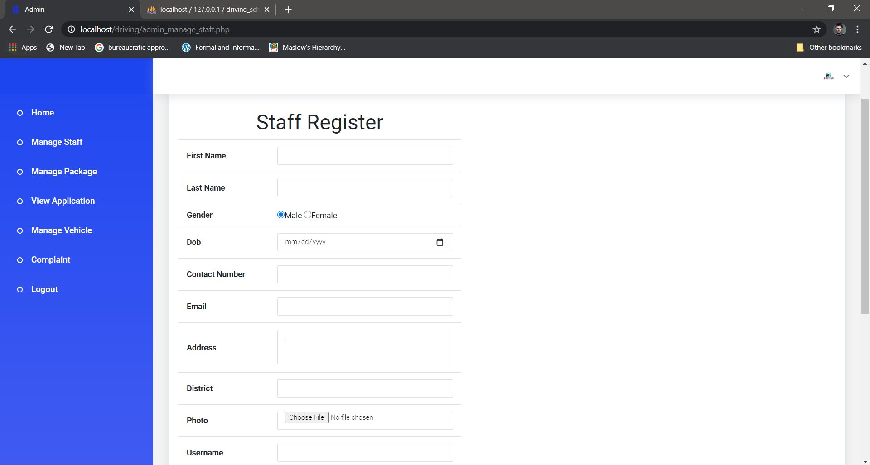

Slide 33
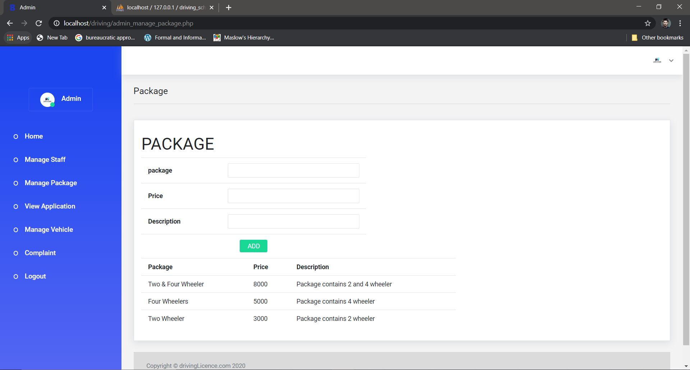

Slide 34
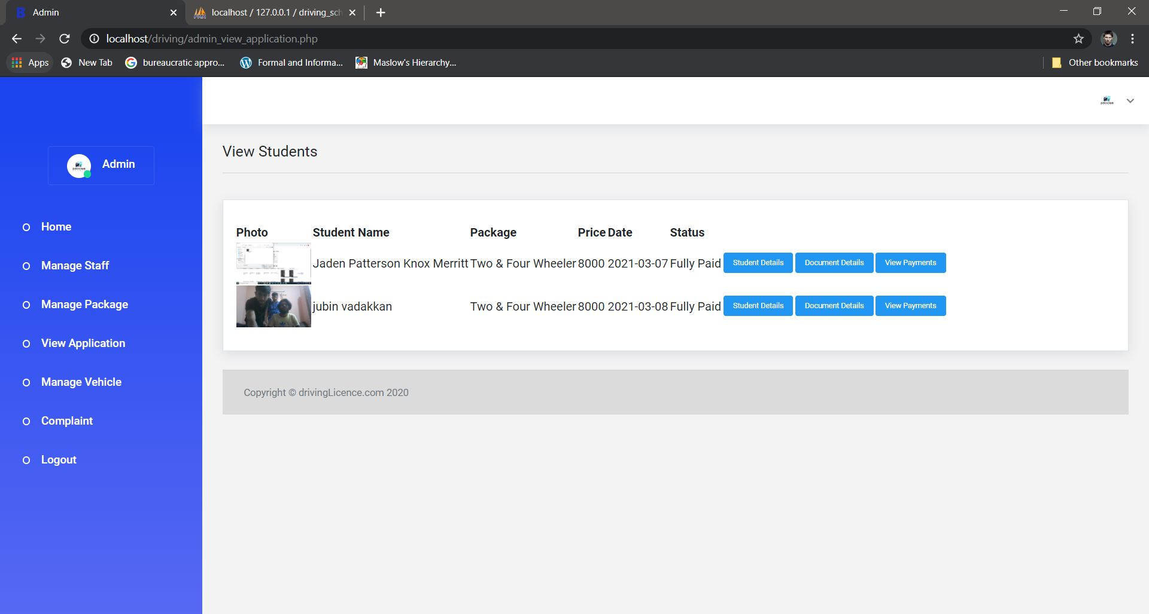

Slide 35
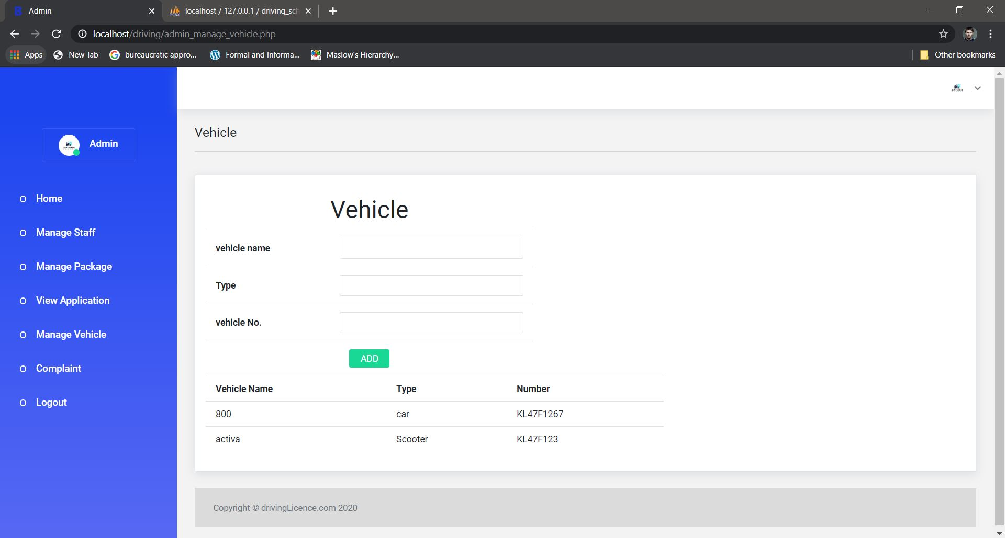

Slide 36
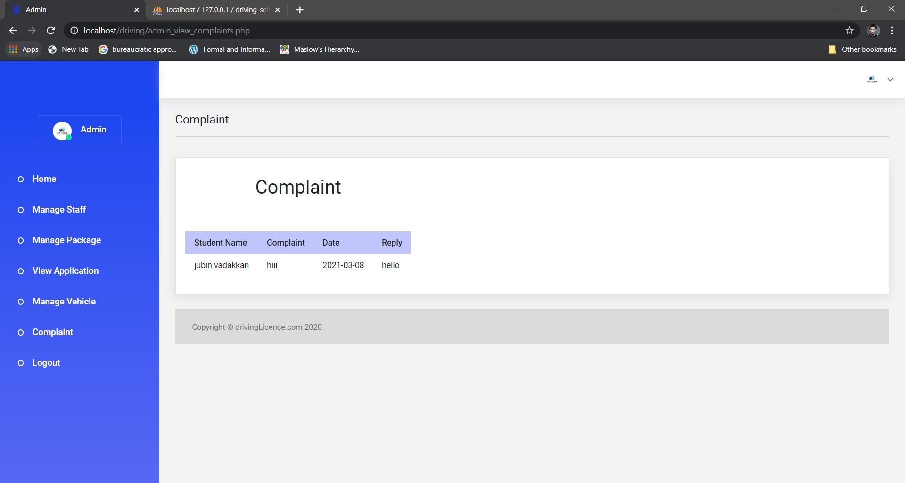

Slide 37
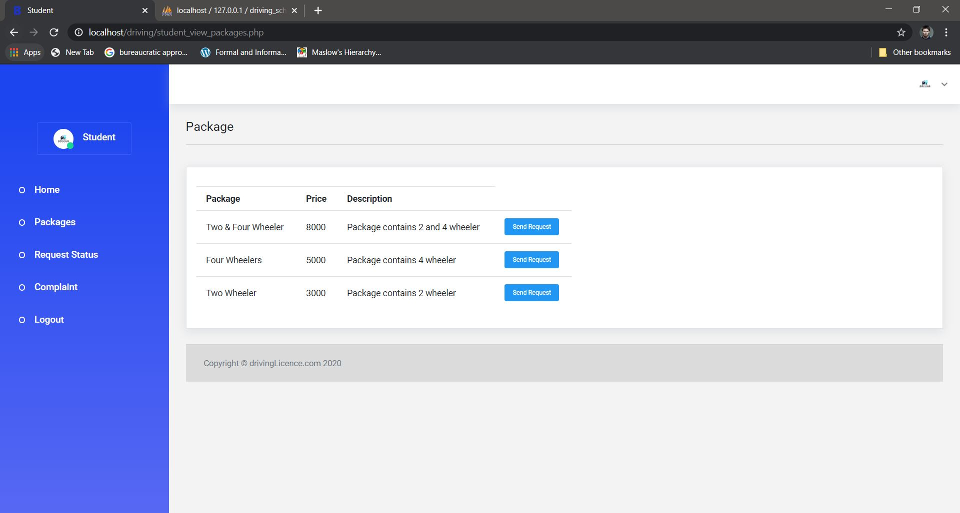
STUDENT

Slide 38
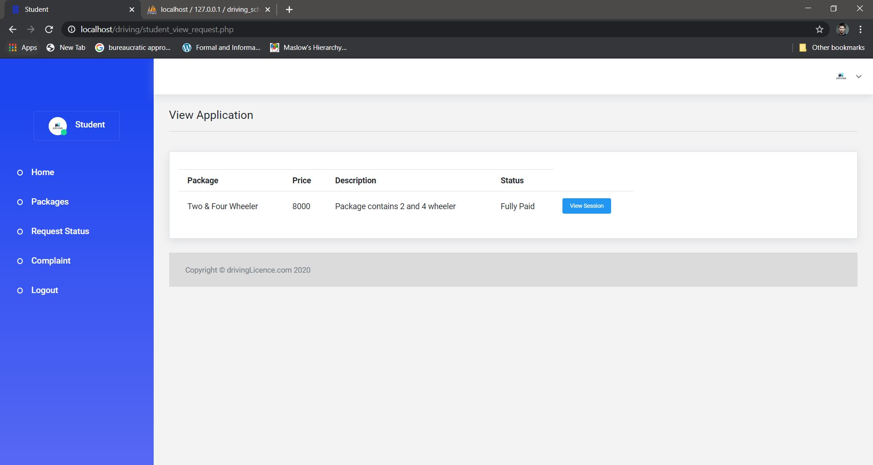

Slide 39
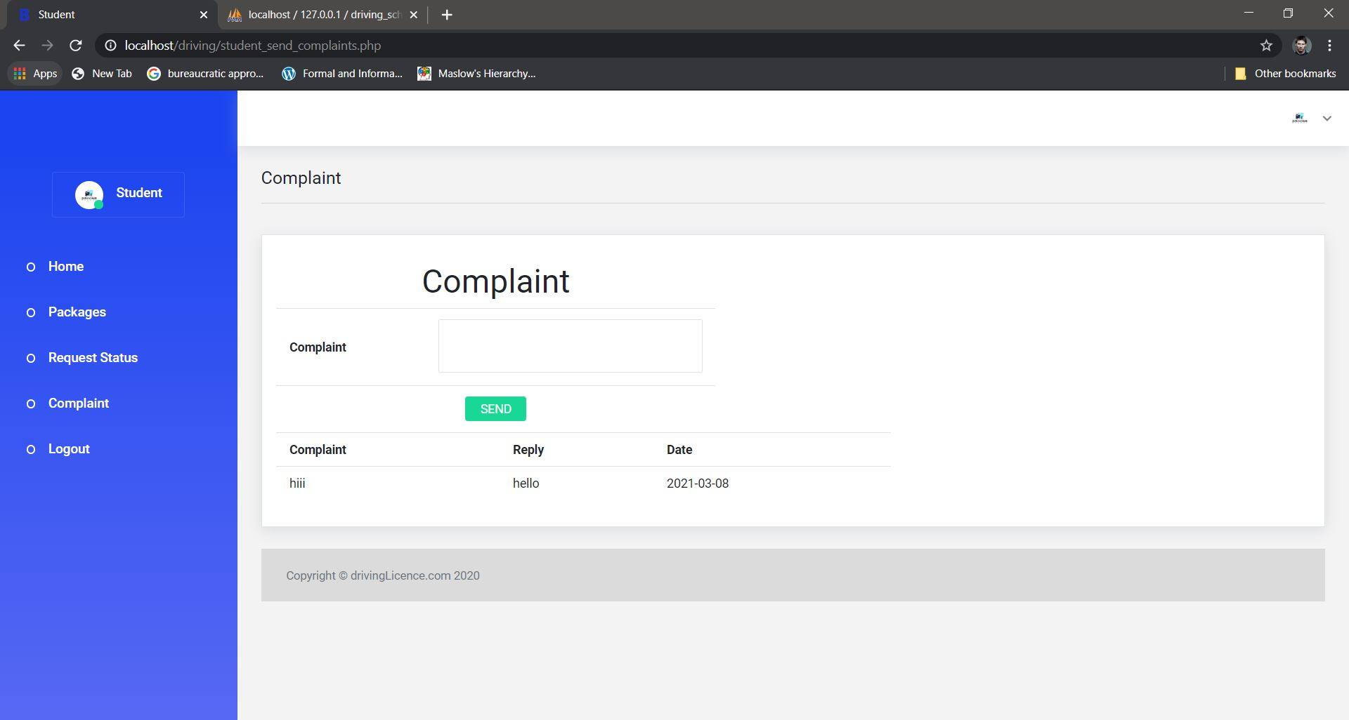

Slide 40
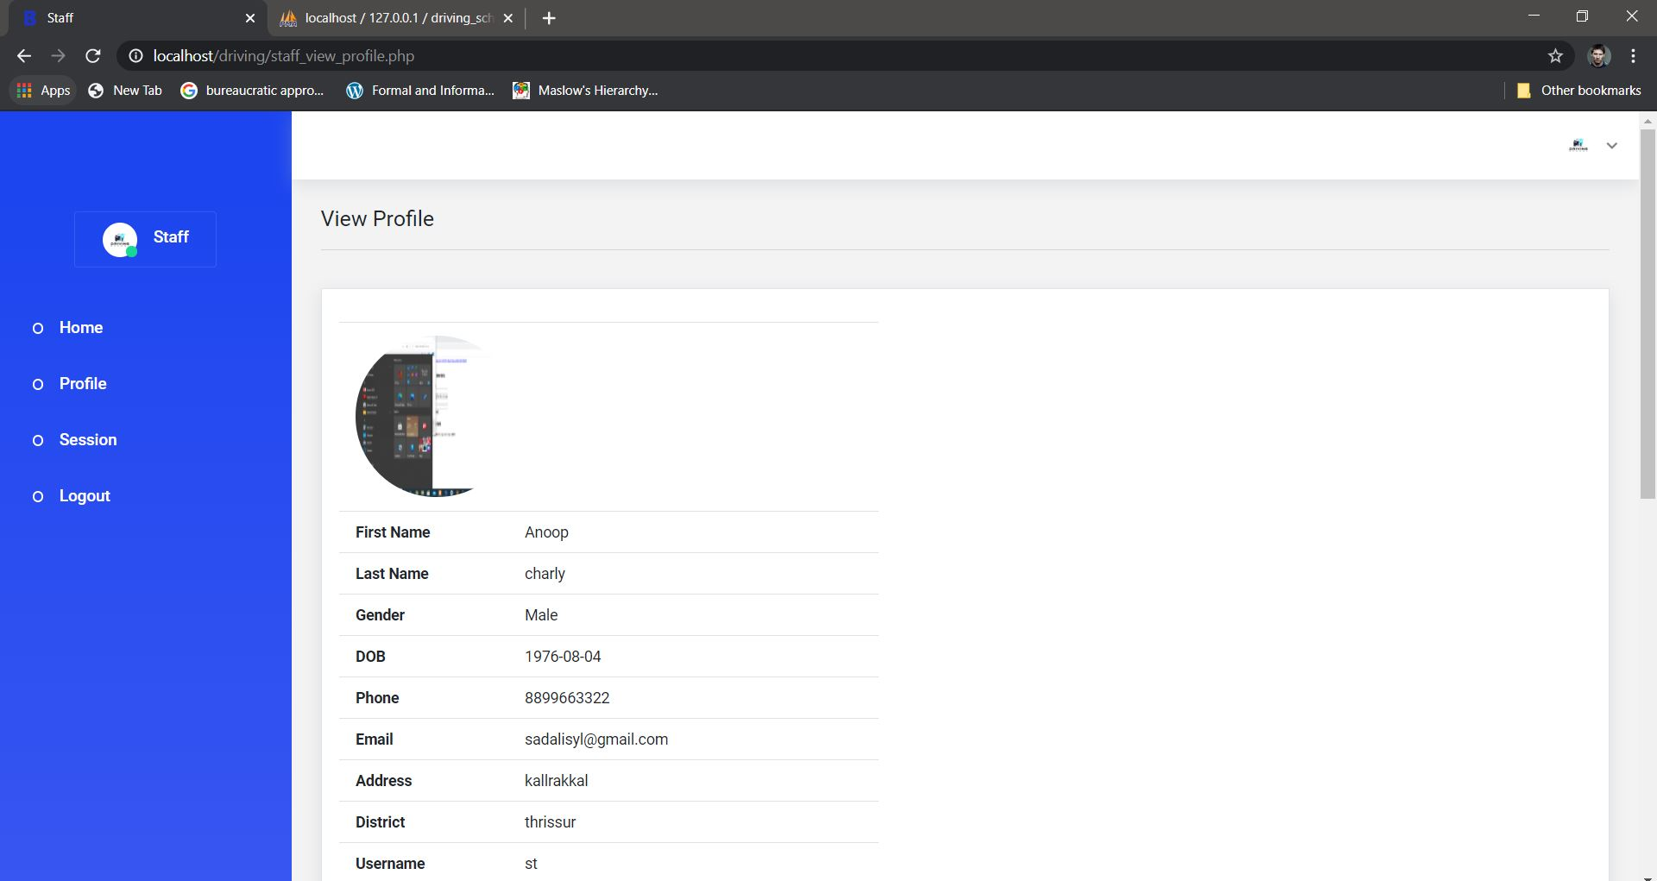
TUTOR

Slide 41
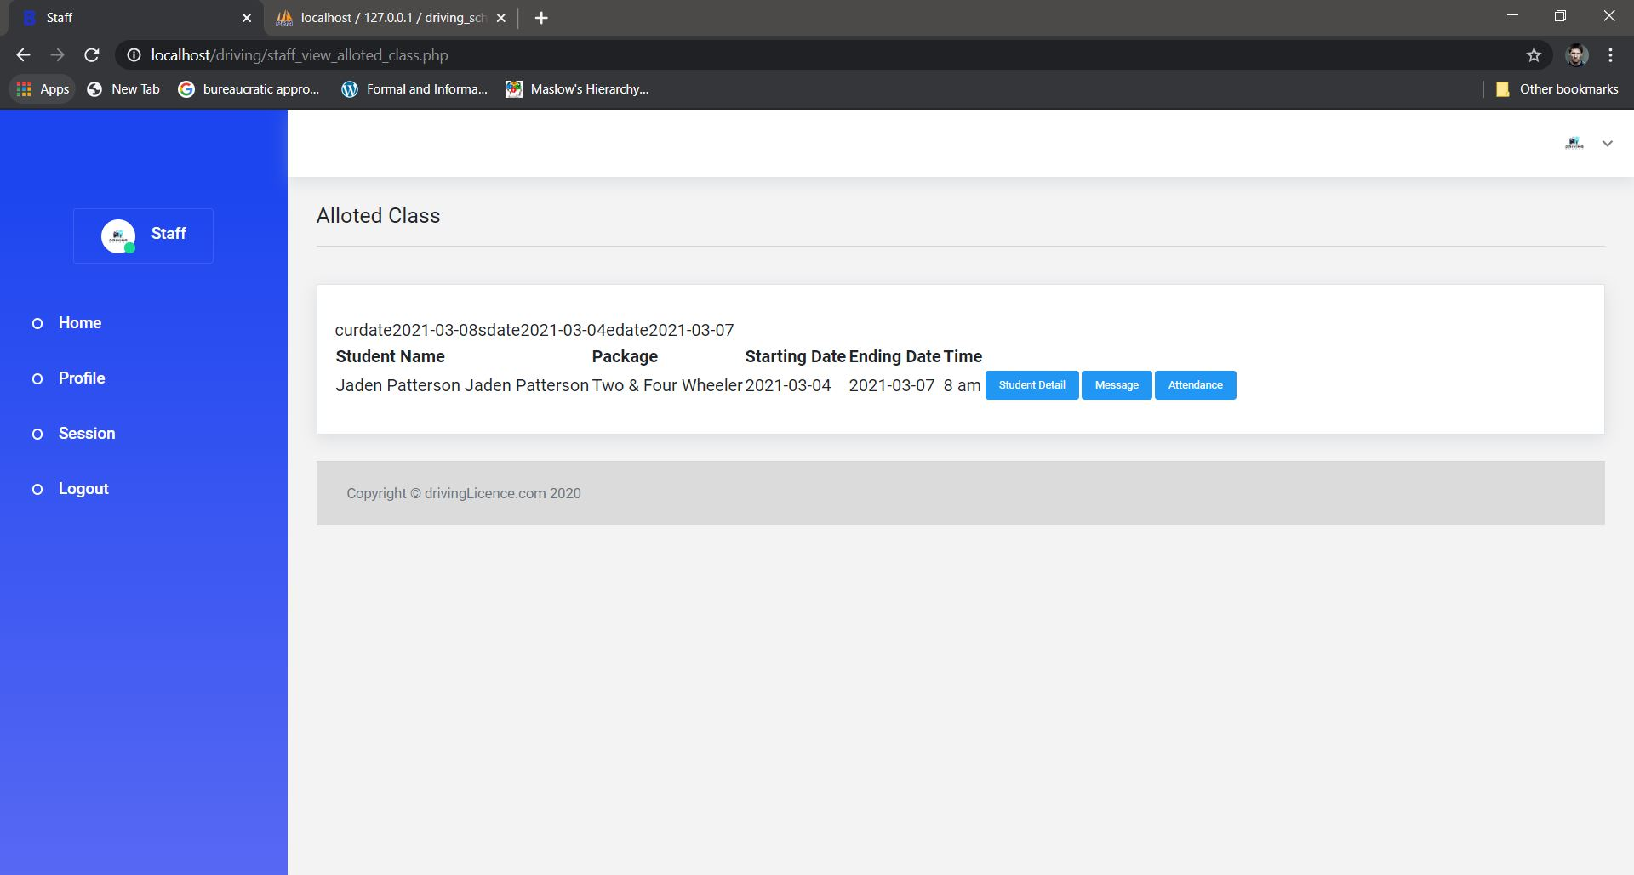

Slide 42
REPORTS

Slide 43
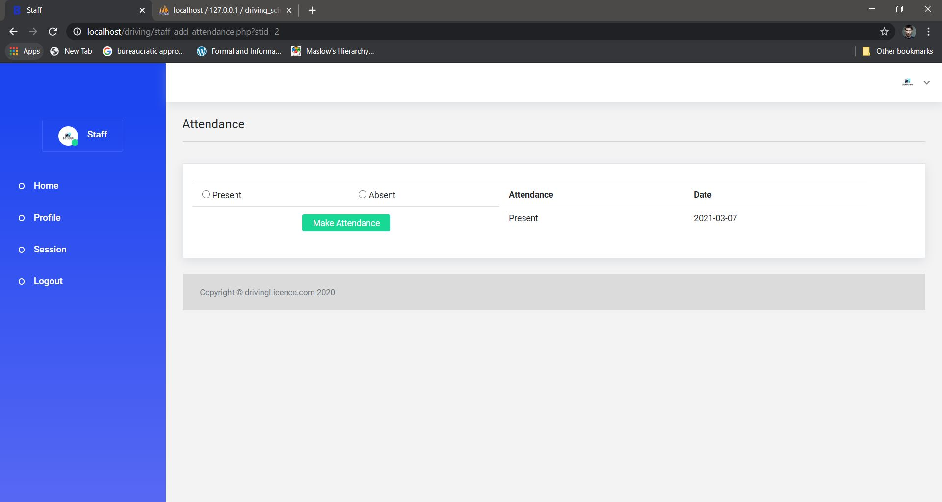

Slide 44


Slide 45
CONCLUSION
The “DRIVING SCHOOL MANAGEMENT SYSTEM” is to be developed to replace such computer system in order to provide a better controlled and efficient environment which will meet the needs of the day’s services.
The student and tutor details are fully systemized so the insertion, updating, deleting process become easy. The processing time is also minimized. The attendance of students were entered day by day by the tutor. The reports can be generated based on the requirement given by the admin

Slide 46
FUTURE ENHANCEMENT
According to the future advancements the modules can be added like online learning portal and online examination
So it will be making more interactive, more user friendly project.

Slide 47
THANK YOU

